Slide 1
PARALLELIZING APRIORI ALGORITHM USING OPENMP AND ITS APPLICATION IN FOREST FIRE PREDICTION
CECS 574
TOPICS IN DISTRIBUTED COMPUTING
BY
NIHAL KUMAR MOTHUKURI
YESHWANTH PABBA

Slide 2

Forest fire

Slide 3
ABSTRACT This is the era of data. There are huge amounts of data being generated every day. Data mining deals with the mining or the understanding of these data and deriving useful information from it. A common way of inferring something from the data is to understand the relationship between the different instances in the data or tuples in the table. This particular form of data mining is called Association Rules Mining (ARM), where associations between the different itemsets in the database are found with the help of various algorithms. A popular ARM algorithm is called Apriori algorithm. This algorithm helps in finding various frequent itemsets in the database. The problem with this algorithm is that it is highly iterative and thus its efficiency rapidly decreases with increase in size or dimension of the dataset. Our project aims to increase the efficiency of the Apriori algorithm using concepts of parallel computing and a few changes in the algorithm.

Slide 4






Real Life examples of Association Rules Mining

Slide 5
Apriori Algorithm
The Apriori Algorithm is an influential algorithm for mining frequent item sets for Boolean association rules.
Apriori uses a "bottom up" approach, where frequent subsets are extended one item at a time (a step known as candidate generation, and groups of candidates are tested against the data).
Key Concepts :
•Frequent Itemsets: The sets of item which has minimum support (denoted by L_{i} for i^{th} -Itemset).
•Apriori Property: Any subset of frequent itemset must be frequent.
•Join Operation: To find L_{k}, a set of candidate k-itemsets is generated by joining L_{k-1} with itself.

Slide 6
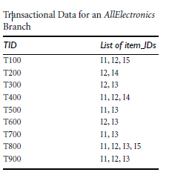
Example: Find the frequent itemset, Min_support =2

Slide 7
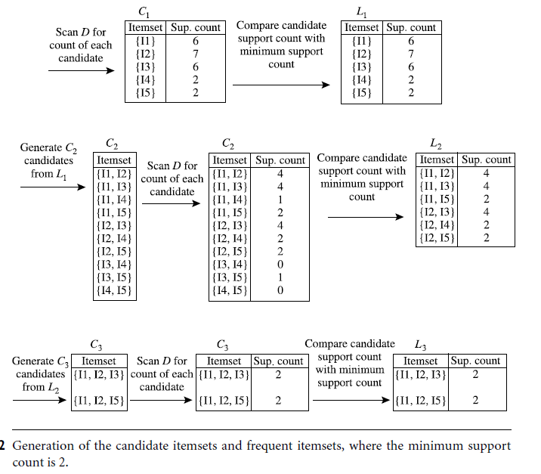

Slide 8
Reason behind PARALLELIZING Apriori Algo
Apriori is an ARM algorithm to find the various frequent itemsets in a database.
There are many drawbacks to the Apriori algorithm like requiring multiple scans of the database, many trivial rules are derived and redundant rules are generated.
Parallel computing concepts shall be used to increase the efficiency of the algorithm by distributing the iterative load to other cores.
A few changes in the algorithm like using QR decomposition to further increase the efficiency.

Slide 9
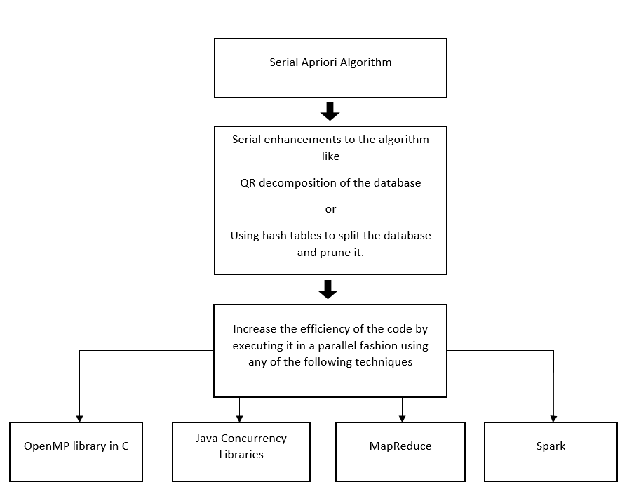
Schematic Representation

Slide 10
Literature Survey
These are many research papers on serial and parallel implementation of Apriori Algorithm.Work has been done on Parallel implementation of Apriori Algorithm based on Map Reduce and one of its application is Hadoop cluster.
Apriori algorithm is also parallelized using openMP and multicore-processors(Quadcore). The main objective is to measure the performance of Apriori algorithm in serial and parallel execution using openMP on a quad core processor.
Apriori algorithm is parallelized using java concurrency libraries in multi core processors.

Slide 11
It is also parallelized using on Graphic Processing Unit. In this method GPU is also run along with the CPU to decrease the execution time of the algorithm, this is called GPU accelerated computing.
QR decomposition is a method in which calculates the similarity between two dimensions of data using their dot product. This is done to increase the efficiency by reducing the dimensions of datasets because Apriori traditionally doesn’t perform well on datasets with large dimensions.
Hash function has also been used to divide the dataset into buckets for easier calculation. Top down approach is used for implementation of the Apriori algorithm by pruning duplicate datasets.

Slide 12
Problem Analysis Chart
Data | Processing | Output | Solution Alternatives
Dataset containing various transactions | Generate the frequent itemsets by calculating the support of every itemset. Support is the percentage of transactions in which the itemset appears . The support of every itemset is then compared with a minimum threshold set by the user. Rules of the transactions are found by calculating the confidence of various itemsets. Confidence is the percentage of the transactions where the presence of an itemset implies the presence of another itemset. | A list of frequent itemsets and rules derived from the given dataset. Predicting forest fire using | Using parallel techniques to enhance the efficiency of the algorithm.

Slide 13
Advantages
This is the most simple and easy-to-understand algorithm among association rule learning algorithms
The resulting rules are intuitive and easy to communicate to an end user
It doesn't require labeled data as it is fully unsupervised; as a result, you can use it in many different situations because unlabeled data is often more accessible
Many extensions were proposed for different use cases based on this implementation—for example, there are association learning algorithms that take into account the ordering of items, their number, and associated timestamps
The algorithm is exhaustive, so it finds all the rules with the specified support and confidence

Slide 14
Achievement
The parallel implementation of the Apriori algorithm reduces the time taken for the algorithm to scan the database. This increases the efficiency of the algorithm and also makes it more usable for real time applications.
The Forest Fire prediction application is one such real time application where the Apriori algorithm is used to predict the occurrence of a forest fire.
Database Transactions | Serial Apriori | Parallel Apriori
10 | 1.7 ms | 1.9 ms
100 | 109 ms | 57 ms
1000 | 15607 ms | 2103 ms

Slide 15
Future Works
The parallel implementation of the algorithm is just the first step in increasing the efficiency.
Further down the road, a data structure can be implemented to retrieve the entire dataset from the database and store it in the memory.
This would drastically decrease the time as the whole process of reading the database is eliminated.
Also, better pruning methods can be used to remove the unwanted itemsets from the candidate list before forming the Apriori level.

Slide 16
REFERENCES: 1. Korde, N. S., & Shende, S. W. (2014). Parallel Implementation of Apriori Algorithm. IOSR Journal of Computer Science. 2. Spandana, K., Sirisha, D., & Shahida, S. (2016). Parallelizing Apriori Algorithm on GPU. International Journal of Computer Applications. 3. Rathee, S., Kaul, M., & Kashyap, A. (2015, October). R-Apriori: an efficient apriori based algorithm on spark. In Proceedings of the 8th Workshop on Ph. D. Workshop in Information and Knowledge Management. 4. Parsania, V., Kamani, G., & Ghodasara, Y. R. (2014). Mining Frequent Itemset Using Parallel Computing Apriori Algorithm. 5. Harikumar, S., & Dilipkumar, D. U. (2016, August). Apriori algorithm for association rule mining in high dimensional data. In Data Science and Engineering (ICDSE), 2016 International Conference on (pp. 1-6). IEEE.

Slide 17
THANK YOU Any Questions..?

